Slide 1
Simple | Smart | Scalable
Technology
2020
www.manifoldcomputers.com

Slide 2
Simple | Smart | Scalable
Technology
2020
www.manifoldcomputers.com

Slide 3
Manifold is a technology Infrastructure company with over
25 Years of experience serving DIVERSE Clients
ABOUT US
SIMPLE
OEM Partnerships, Certiﬁed Experts, and Clear SLAs
SMART
Intelligent Products, Applications, and infrastructure
SCALABLE
Cloud ready Products, Solutions, and Services

Slide 4
PRODUCTS/SERVICES
Manifold can provide you with End to end Technology infrastructure services and products
Business services
Commercial Business Unit
Procurement Services
Technology Business Unit
Design
Deployment
Managed Services
Products
End User: Computing, Collaboration, and Printing
Infrastructure: Servers, Networking, and Storage
Software: Virtualization, Security, and Monitoring
Managed Services: Devices, Printing, and Data Center

Slide 5
COMMERCIAL BUSINESS UNIT
ABOUT US
PRODUCTS
OEM
KEY BUSINESS IMPERATIVES
Desktop
Laptop
Printer
Display
Cables
IP Phones
Accessories
MPS
Consumables
HPI
Lenovo
Dell
Samsung
Apple
Acer
Avaya
Jabra
Zebra
Dlink
Startech
APC
Panasonic
LG
Canon
Epson
Fujitsu
OEM Relationship / Partnership Level
On time delivery
Price
Payment terms
Communication (swift response)
Genuine Product / warranty

Slide 6
ENTERPRISE BUSINESS UNIT
ABOUT US
Driving Digital Transformation For Enterprise
MODERN IT INFRASTRUCTURE
CYBER SECURITY
ADVANCE ANALYTICS

Slide 7
Empowering Digital Transformation Objectives
BUSINESS OUTCOMES
Business Agility and Innovation
+
Exceptional Mobile Experiences
+
Protection of Brand and Customer Trust
Modernize Data Centers
Integrate Public Clouds
Empower Digital Workspaces
Transform Security
Automate IT
STRATEGIC IT PRIORITIES

Slide 8
Empowering Digital Transformation Objectives
IT Initiatives are Aligned to Customer Strategic Priorities
Digital Transformation
Modernize Data Centers
Integrate Public Clouds
Transform Networking and Security
Empower
Digital Workspace
STRATEGIC PRIORITIES
Software-Defined Private Cloud
Hybrid Cloud
Agility by Automation
Next Gen Apps
Secure App Infra
Embrace Cloud Networking
Unify the Branch / Edge
Secure Access Mgmt
Unify Endpoint
Mgmt
Simplify Windows Delivery
IT INITIATIVES
HCI Powered Private Cloud / SDDC

Slide 9
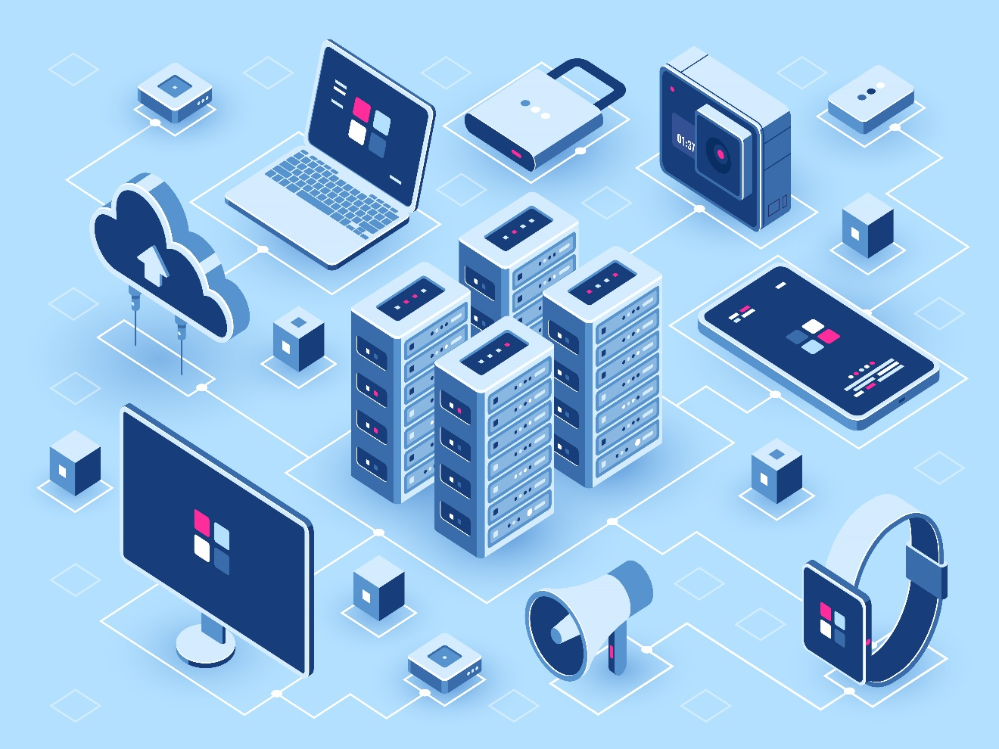
ENTERPRISE BUSINESS UNIT
ABOUT US
MODERN IT INFRASTRUCTURE
Software defined infrastructure (converged/hci)
Virtualization – Compute, storage, network
Containerization – DevOps, Micro services
Middleware
Business Continuity Solutions
Cloud Solutions – IaaS, PaaS, SaaS
IT operations Management & Orchestration Solutions
Modular Datacenter

Slide 10
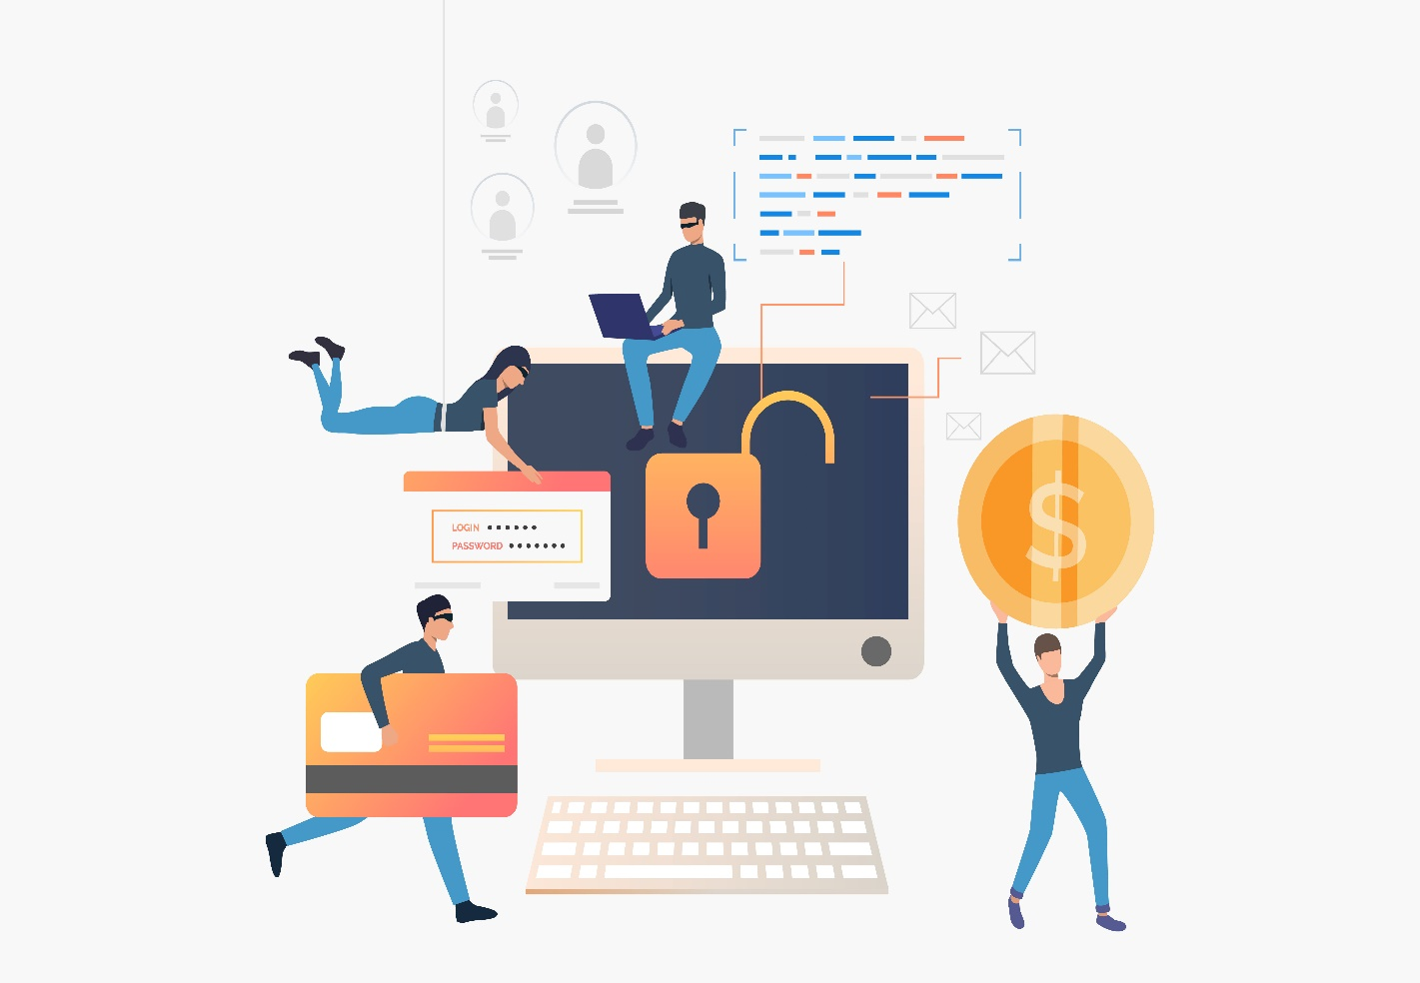
ENTERPRISE BUSINESS UNIT
ABOUT US
CYBER SECURITY
Gateway security
Data security
End point security
Access management solutions
Application security
SIEM solution

Slide 11
ENTERPRISE BUSINESS UNIT
ADVANCE ANALYTICS
Business Intelligence
Advanced analytics – Predictive/Prescriptive Analytics
Machine learning
Artificial intelligence
Big data solutions
ETL solutions
Robotic Process Automation
IOT solutions
Robotic Process Automation

Slide 12
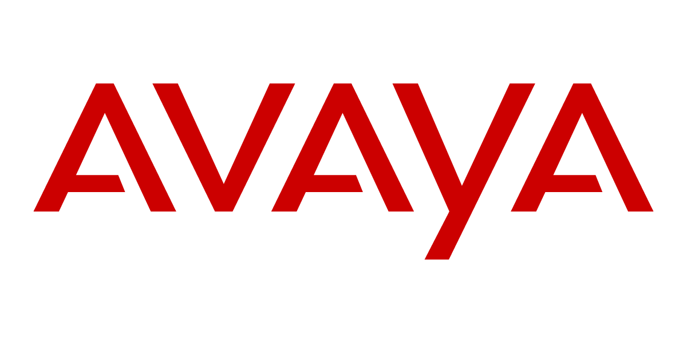
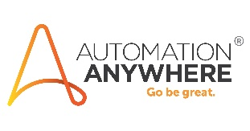
Selected OEMs
SELECTED OEMS
Manifold is a single point of contact for the best technology infrastructure Products, Solutions, and Services

Slide 13
Organization Structure
Sales Team
Technology Business Team
Modern Data Center Infrastructure and Advanced Analytics - Pre-Sales
Implementation & Support - Post Sales
A.I.I. - Akitoye Delano
A.I.I. - Yusuf Adeyemo
Adedayo Oluyemi
TBH
A.I.I. – TBH (CCIE)
Cyber Security – TBH
A.A. – Akitoye Delano
A.A. – Yusuf Adeyemo
A.A. - TBH
Oil & Gas
Olumide Aki
Adewale Anifowose
Alfred Anso
BFSI
Henry Olatunbosun
TBH
Mid Market & Telco
Sodiq Akande
Public sector
Blessing Azuaru
Commercial Business Unit
Ololade Ogunbunmi
Bola Lawal
Adeshina Adekunle
IOT solutions
Robotic Process Automation

Slide 14
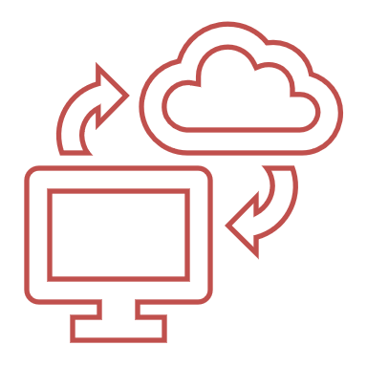
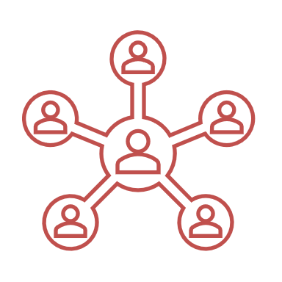
Manifold makes transformative technology infrastructure Simple, Smart, and scalable
SOLUTION PORTFOLIO
Hyper Converged Infrastructure and Software Defined Data center
Hybrid Cloud Strategy and Optimizations
Workspace Transformation and Mobility
Automation and Artificial Intelligence
Software Defined - WAN
Security & Compliance

Slide 15
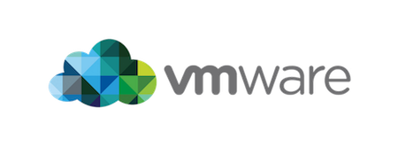
Hyper Converged Infrastructure can reduce scalability costs by 60%
SOLUTION PORTFOLIO
CURRENT STATE
KEY FEATURES
BUSINESS IMPACT
Organizations generates petabytes of operational and customer data
Traditional Data Centers are ineﬃcient and sub-optimized
High capital and operating costs of traditional storage and expanding storage needs
Software Deﬁned for integrated compute, storage and networking
Built for multi-cloud world to shift workloads from private and public clouds
Virtualized resources enables integration agnostic of OEM components
Simplify management of diﬀerent DC components
Future proof your entire infrastructure and avoid platform lock-in
Integrate existing gears and scale with ease as workload increases
Selected OEMs

Slide 16
Software-Defined Data Center (SDDC)- Unified Data Center Platform Gain unprecedented automation, flexibility and efficiency and transform the way you deliver IT
SOLUTION PORTFOLIO
CURRENT STATE
KEY FEATURES
BUSINESS IMPACT
CIOs and IT administrators are looking to deploy and run a private cloud.
Managing and controlling diverse infrastructure which creates operational complexity
Delivering service-level agreements at the enterprise level to mission-critical apps while keeping costs under control
Fully Automated with rapid setup and configuration of the entire SDDC
Automated Infrastructure Lifecycle Management with monitoring, capacity planning and log analytics
Integrated Management of Physical and Virtual Infrastructure
Easily scale up and out capacity
Faster Time to Value
Minimize IT Spend
Eliminate Vendor Lock-in
Free IT Staff for Innovation
Unmatched Efficiency and Resiliency
Selected OEMs
Notes:
Outcomes Delivered by a Software-Defined Data Center
Data Center Virtualization and Hybrid Cloud Extensibility – Significantly reduces CapEx by standardizing services on logical resources and simplifying the data center footprint
Streamlined and Automated Data Center Operations – Drives ongoing operational efficiency and helps administrators spend more time on value-added projects
Application and Infrastructure Delivery Automation – Rapidly delivers holistic IT services on demand, from traditional multitier applications—Exchange, for example—to in-memory databases—HANA and GemFire, for example—to distributed high-performance computing workloads—Hadoop, for example
Security Controls Native to Infrastructure – Shifts security from perimeter defense to fine-grained isolation with microsegmentation
High Availability and Resilient Infrastructure – Simplifies the architecture needed to support business continuity and automation of the disaster recovery process

Slide 17
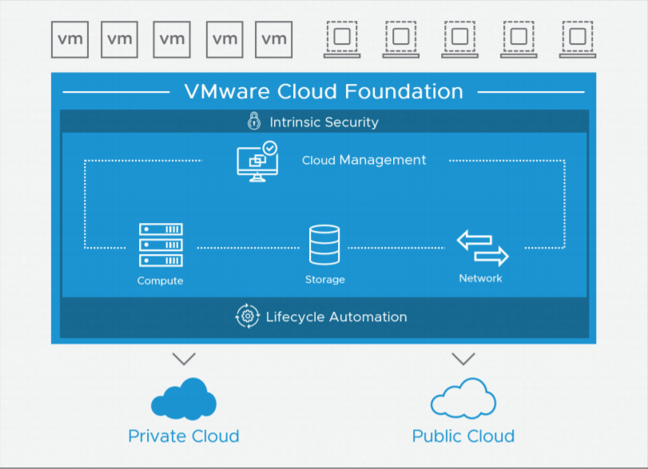
VMware Cloud Foundation
Key Solution - SDDC
VMware Cloud Foundation™, the industry’s most advanced hybrid cloud platform that provides a complete set of software-defined services for compute, storage, networking, security and cloud management to run enterprise applications—traditional or containerized—in private or public environments.
VMware Cloud Foundation drastically simplifies the path to the hybrid cloud by delivering a single integrated solution that is easy to deploy and operate, enabled by built-in automated lifecycle management.
KEY FEATURES
Natively Integrated Software-Defined Stack
Enterprise-Grade Services
Storage Elasticity and High Performance
Self-Driving Operations
Self-Service Automation
Built-in Intrinsic Security
Notes:
VMware Cloud Foundation makes it possible for organizations to benefit from the full power of VMware’s market-leading software-defined architecture with enhanced operational efficiency across private and public clouds. As a result, Cloud Foundation dramatically shortens the path to a complete hybrid cloud, increasing admin productivity. Customers can achieve the following when compared to legacy hardware-defined data centers:
• Up to 15x faster time to market by eliminating complex processes around system
design, testing, bring-up and configuration
• Increase admin productivity by up to 2x by automating day 2 operations such as
patching, updates, and monitoring
• Risk-free repeatable deployment of IT footprint anytime, anywhere
• Up to 40 percent reduction in TCO of private cloud deployments
• Elimination of hardware cost when consuming as a service from the public cloud
• Portability of workloads between private and public clouds

Slide 18
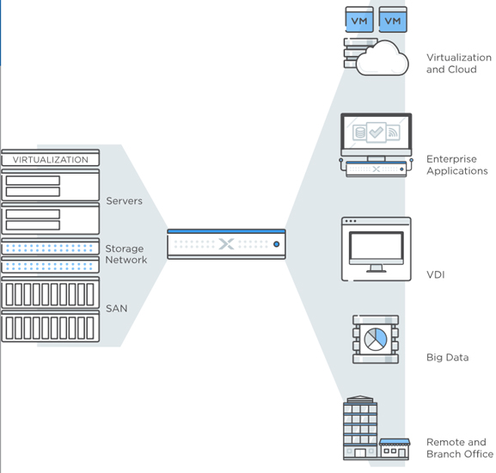
Nutanix Enterprise Cloud Platform
Key Solution - SDDC
Nutanix delivers solutions to elevate IT to focus on the applications and services that power business. At the heart is the Nutanix Enterprise Cloud Platform that natively converges several aspects of the datacenter infrastructure through a software-defied solution with rich machine intelligence.
Nutanix provides the benefits of both public and private clouds. The Nutanix Enterprise Cloud Platform delivers the frictionless agility, simplicity and fractional consumption of public cloud services while providing platform choice, performance, security, and control within their datacenter. With Nutanix Enterprise Cloud Platform, customers get
KEY FEATURES
Full-stack IT infrastructure and platform services
Pay-as-you-grow economics
One-click operations
Application mobility
Notes:
The platform integrates an enterprise-grade hypervisor, Nutanix AHV, so virtualization no longer has to be separately purchased and managed. Storage is delivered as a set of software-defined services—including VM storage supporting almost any virtualized workload, block storage for bare-metal and external applications, file storage for end-user files and virtual desktop deployments, and persistent storage for container-based applications. The solution also includes resiliency, native data protection and disaster recovery to enable high application availability. Nutanix Enterprise Cloud Platforms are built on web-scale engineering principles: software-defined, fully distributed with no single point of failure, and built-in self-healing. With a comprehensive infrastructure stack, administrators can finally focus on the applications that power their businesses as opposed to disparate pieces of infrastructure.
Capacity can be added on-demand with a single click and no disruption to production applications. Linear scaling yields predictable performance and capacity as resources are added.
The Nutanix Enterprise Cloud Platform is built with a technology agnostic architecture, enabling IT teams to select the right hypervisor, hardware platform and cloud to meet the IT and business requirements for every application.
Nutanix Enterprise Cloud Platform provides simple, powerful management spanning across private and public clouds through Nutanix Prism. An intuitive interface and comprehensive set of REST APIs enables complex operations to be either automated or accomplished with one-click across the entire stack.

Slide 19
Cloud Management and Automation Platforms with Native integrations across the SDDC. Fewer integrations and faster deployments
SOLUTION PORTFOLIO
CURRENT STATE
KEY FEATURES
BUSINESS IMPACT
Most organizations start with a focus on infrastructure as a service
Virtual infrastructure in Data Centers are ineﬃcient and sub-optimized
Organizations are looking to integrate cloud native or container-based applications into the scope of services they deliver
Intent-Driven Continuous Performance Optimization Assure application performance based on business and operational intent
Real-time, predictive capacity & cost optimization
Predict, prevent and troubleshoot across SDDC, public cloud provider with simplified UI, enhanced dashboarding and native integrations
Use Resources Efficiently and Speed up infrastructure delivery
Meet SLA Commitments and Get more productivity out of data center resources
Provide a Unified View and Increase Staff Productivity
Selected OEMs

Slide 20
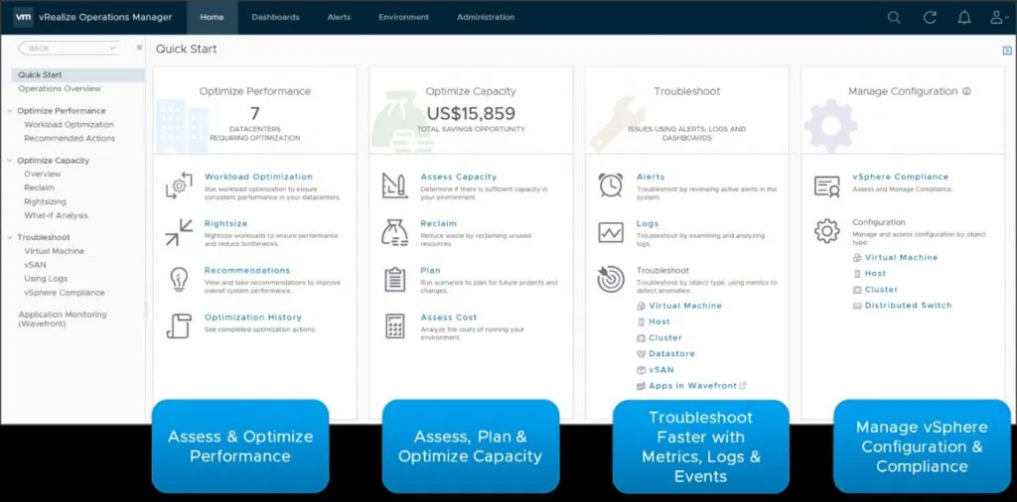
Self-Driving Operations by VMware vRealize Operations
Key Solution - CMP
Self-driving operations by VMware
vRealize® Operations™ delivers continuous
performance optimization at minimal cost
driven by business and operational intent,
efficient capacity management, proactive
planning, intelligent remediation, and
integrated compliance. It automates and
simplifies IT operations management,
and provides unified observability from
applications to infrastructure across hybrid
cloud and multi-cloud environments
KEY FEATURES
Centralized management for software defined data center (SDDC) and hybrid cloud environments
Intent-driven automated workload balancing
Host-based placement for software license separation and cost control
Real-time, predictive capacity analytics to proactively alert on capacity risk, forecast demand, and deliver actionable recommendations
Support for both demand- and allocation used capacity models
Integration of costs with capacity analytic
Notes:
Continuous performance optimization – Assure performance at minimal cost, driven by operational and business intent with predictive analytics driving actionsto automatically balance workloads and proactively avoid contention. Automate workload balancing to reduce software license costs, optimize based on performance tiers, densify clusters, or enforce compliance.
Efficient capacity management and planning – Reduce cost and capacity risk with real-time, predictive capacity analytics, delivering optimal densification and proactive planning. Predict future demand, get actionable recommendations, and automate reclamation and right-sizing. Integrate costs and capacity analytics to optimize utilization and reduce costs. Advanced what-if scenarios help plan capacity and model best-fit for new workloads, hardware procurement, and migration planning to public clouds.
Intelligent remediation – Predict, prevent, and troubleshoot faster with actionable insights correlating metrics and logs, and unified observability from applications to infrastructure. Centralize IT operations management with native SDDC integrations, federated views, and a highly scalable and extensible platform. Integrated Compliance – Reduce risk and enforce IT and regulatory standards for vSphere with integrated compliance and automated drift remediation. Ensure your environment’s adherence to common requirements such as PCI and HIPAA, or create your own custom templates.

Slide 21
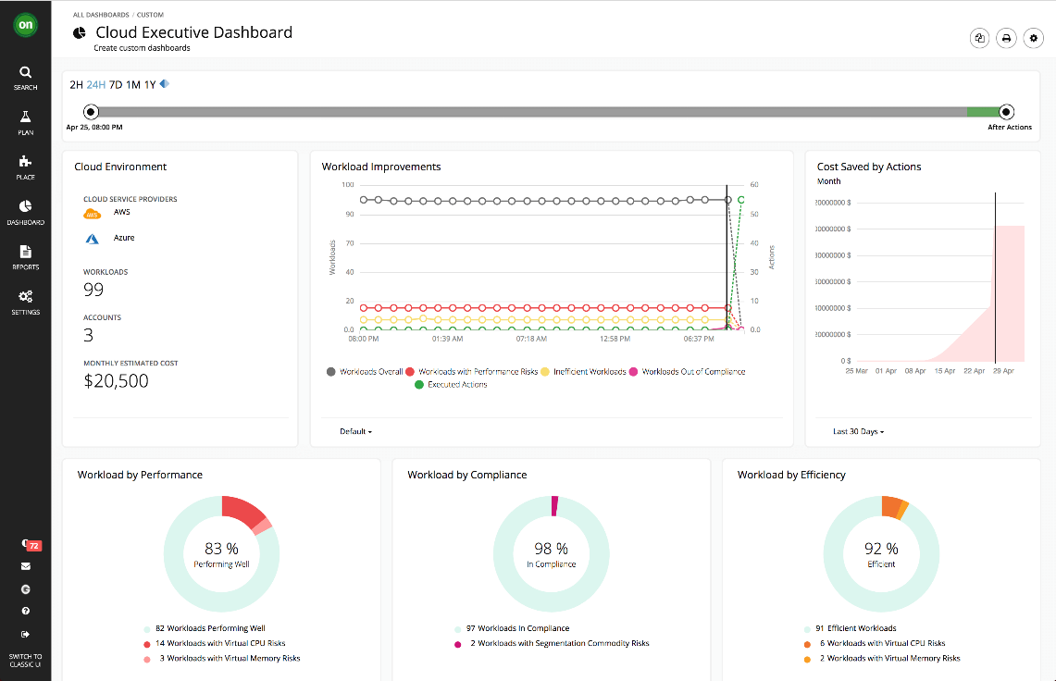
Application driven cloud optimization by Turbonomic
Key Solution - CMP
The most important objective of IT infrastructure is to provide applications with the resources they need to deliver their services levels. A companion objective is to do this as cost efficiently as possible and adapt to changing environment and application demand scenarios by dynamically adjusting resources over time
Turbonomic offers full stack visibility and control into every environment it manages. Turbonomic understands the relationships between the layers, the available capacity of resources and fluctuating demand of the application and is able to execute actions at each layer to assure application performance.
KEY FEATURES
Application-Aware Optimization
Support On-Premises, Hybrid, and Multicloud Deployments
Full Stack Visibility and Control
Trustworthy & Automatable Actions
Enforce Business Policy Compliance
Notes:
Multicloud resource optimization represents a remarkably complex undertaking, introducing challenges on a scale that IT has never faced. Business leaders and IT operations alike must look for new ways to keep pace as the business adopts new technologies. Future planning must contemplate the speed at which these technologies evolve. The current generation of reactive tools that rely primarily on monitoring, threshold-based alerting, show back reports and manual remediation will not work at scale. A successful application driven cloud optimization solution must be able to provide continuous performance assurance while driving maximum cost efficiencies.
Turbonomic is used by over 2,100 customers, including more than 100 of the Fortune 500, enabling enterprises and public agencies and entities to unlock agility and elasticity in their onpremises and multicloud environments so they can shift from reactive IT operations management to investing a higher percentage of their budgets and valuable people resources to driving business innovation.

Slide 22
Robotic Process Automation (RPA) - Automate any business process, enabling enterprises to create a digital workforce to manage and scale business processes with unprecedented speed.
SOLUTION PORTFOLIO
CURRENT STATE
KEY FEATURES
BUSINESS IMPACT
Organization are trying to take advantage of AI, cloud and big data to transform their business
Organizations need to speed-up data fulfillment validation and reporting
Improve or eliminate manual reporting activities while improving consistency of reports
Enterprise-grade solution ensures reliable, scalable and powerful RPA, With bank-grade security architecture and centralized controls
Auto-calibration technology enables our Bots to sense and automatically adjust to application changes immediately.
Cognitive capabilities enable bots to study and enhance processes to increase reliability and accuracy.
Automate Key process and free up time and resources
Eliminate manual effort and reduce processing time with error free data
Streamline analysis and decision making with faster and intelligent reporting
Selected OEM

Slide 23
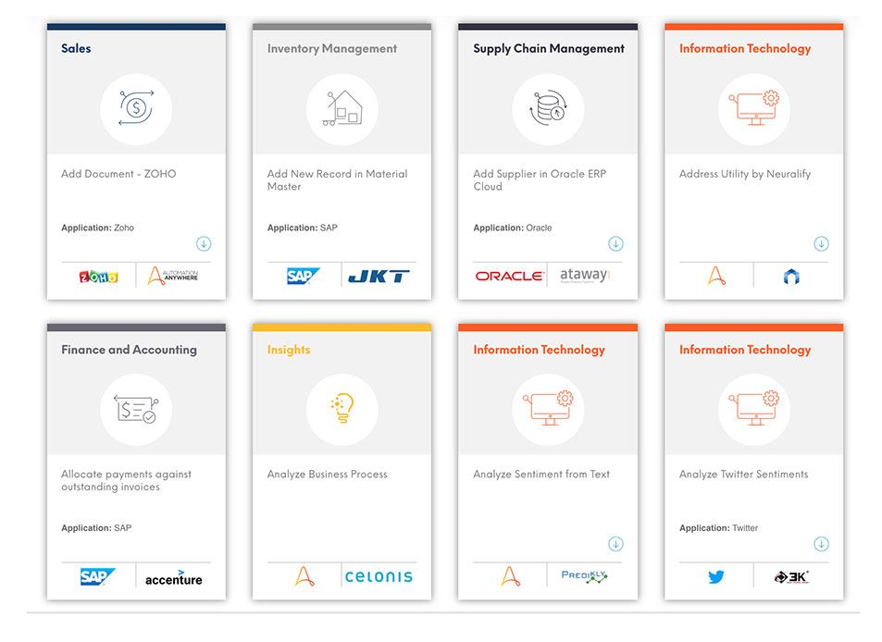
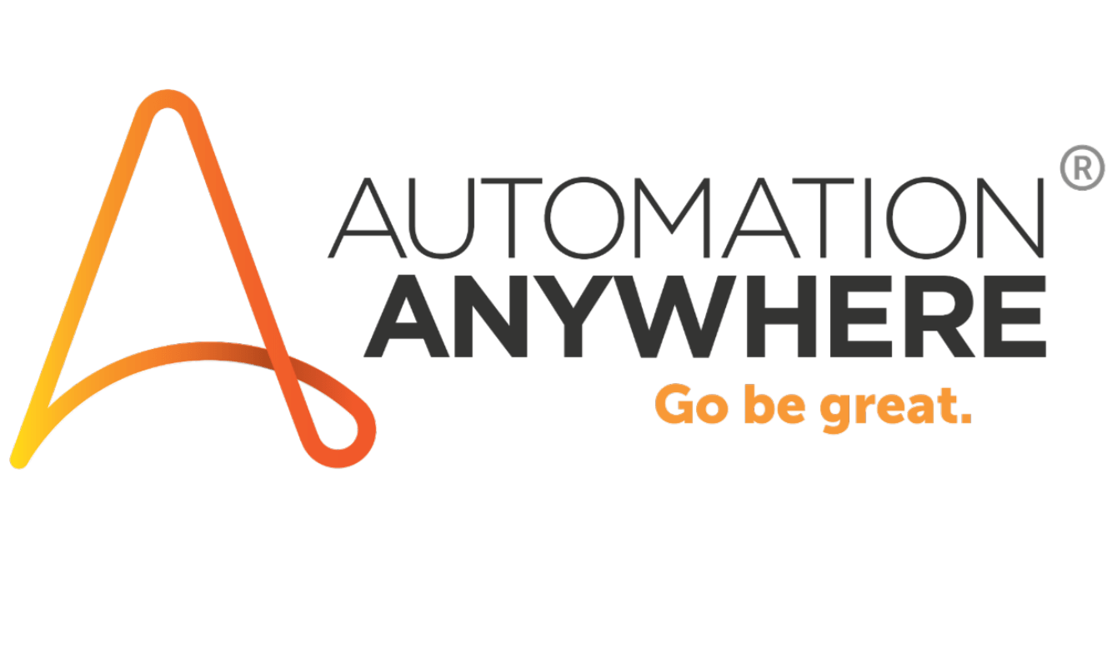
Robotic Process Automation platform for Shared Services and Business Service Organizations
Key Solution - CMP
Automation Anywhere’ s enterprise-grade cognitive robotic process automation (RPA) platform is capable of automating any business process, enabling enterprises to create a digital workforce to manage and scale business processes with unprecedented speed.
Automation Anywhere is the recognized RPA leader in creating the new digital workforce. Having pioneered RPA for more than 12 years and with over 27,000 customers, their enterprise-class solution offers greater efficiency, agility and control with near-zero error rates
KEY FEATURES
ANY APPLICATION. With over a decade of automation experience, the platform has automated every application, from SAP to legacy applications.
ANY PROCESS. We’ve automated every phase of a business process, from back office functions in IT, HR and F&A to front office and mid-office, including thousands of the most complex end-to-end processes.
ANY INFRASTRUCTURE. The platform is infrastructure-agnostic; it is deployable from virtual infrastructures in public or private cloud environments, to server-based processing and even to the desktop.
Notes:
Administrators can rapidly spin up desktops that retain user customization, persona, and user-installed apps from session to session, even though the desktop itself is destroyed when the user logs out. Similarly, published applications can be deployed 5–10x faster with a push of a button and with less than half the required steps when compared with competitive solutions. Virtual desktops benefit from the latest OS and application patches automatically applied between user logins, without any disruptive recompose, resulting in the elimination of patch maintenance windows. This capability is delivering customers the VDI nirvana of fully customized and personalized desktops, built on the economics and security of stateless, nonpersistent desktops.
Customers can choose between Blast Extreme, PCoIP, and RDP based on their use cases and client device choices. Blast Extreme offrs many inherent advantages over PCoIP in addition to client device support including:

Slide 24
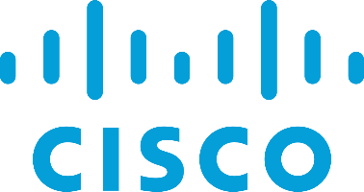
Workspace Transformation and Mobility – work safely and securely from anywhere and enable BYOD
SOLUTION PORTFOLIO
CURRENT STATE
KEY FEATURES
BUSINESS IMPACT
Simplify the move to the mobile cloud era.
Every employee desires a level of flexibility in the working hours and the freedom to leave the office anytime without leaving the work behind.
Securely deliver and manage Windows or Linux desktops, applications, and online services to end users
The VDI makes your process independent of hardware restrictions as well as hassles.
Virtual Desktop Infrastructure helps the businesses to keep their data secure by eliminating the local storage of data whatsoever
Instead of buying new PCs, repurpose your existing devices
No Hardware Issues
Easy Provisioning of Desktops
Turn to thin and zero clients to drive down your power costs and to extend the lifecycle of your endpoints.
Selected OEMs
Notes:
VDI
Collaboration
Network Access control

Slide 25
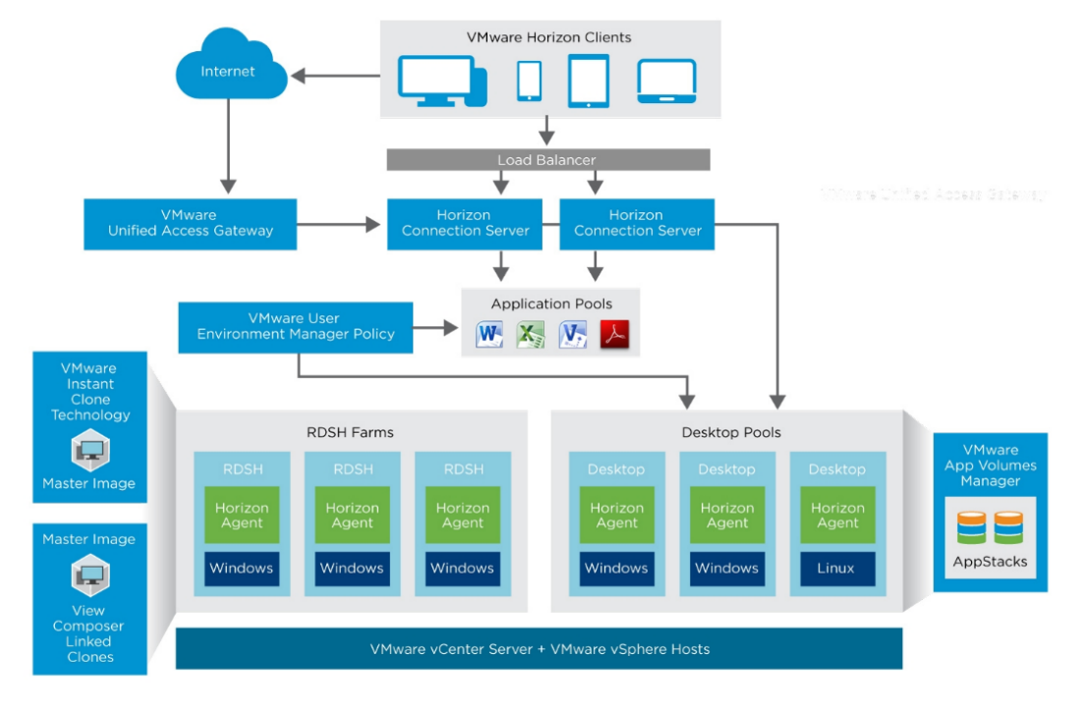
Desktop & App Virtualization Reimagined VMWARE HORIZON 7
Key Solution - CMP
VMware Horizon® 7 goes beyond VDI to provide end users with one place to securely access all their desktops, applications, and online services from any device, everywhere. With Horizon 7, IT organizations can take advantage of closed-loop management and automation, and tight integration with the software-defied data center, to deliver and protect all the Windows or Linux and online resources users want, at the speed they expect, with the efficiency business demands.
KEY FEATURES
Dramatically accelerated means to provision fully featured, personalized, customized virtual desktops and published applications.
PCoIP, VMware now offers customers additional choice and flexibility
Robust suite of security and policy-focused capabilities that help customers improve their overall security posture, with a multilayered, defense-in-depth approach
Notes:
Administrators can rapidly spin up desktops that retain user customization, persona, and user-installed apps from session to session, even though the desktop itself is destroyed when the user logs out. Similarly, published applications can be deployed 5–10x faster with a push of a button and with less than half the required steps when compared with competitive solutions. Virtual desktops benefit from the latest OS and application patches automatically applied between user logins, without any disruptive recompose, resulting in the elimination of patch maintenance windows. This capability is delivering customers the VDI nirvana of fully customized and personalized desktops, built on the economics and security of stateless, nonpersistent desktops.
Customers can choose between Blast Extreme, PCoIP, and RDP based on their use cases and client device choices. Blast Extreme offrs many inherent advantages over PCoIP in addition to client device support including:

Slide 26
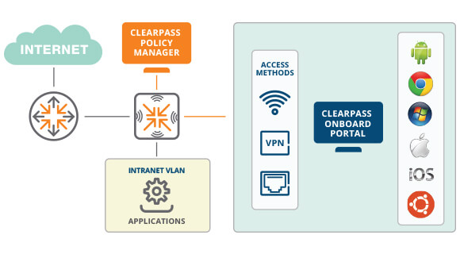
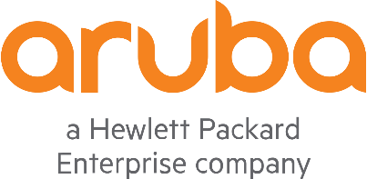
Solving The BYOD Challenge with Aruba ClearPass
Key Solution - CMP
Access should be simple – for students, staff, corporate guest or contractor, or BYOD. ClearPass Guest, OnBoard and OnGuard gives you the tools you need and the flexibility to secure your business Wi-Fi and wired networks.
Clear pass Onboard automatically configures and provision mobile devices – Window macOS, iOS, Android Chromebook and Ubuntu enabling them to securely connect to enterprise networks in support of BYOD initiatives
KEY FEATURES
Enable users to self register and securely onboard multiple devises
Sponsor based onboarding allows for custom workflows
Actives directory and cloud identity credential authentication supported
Automate the configuration of network settings for wired and wireless endpoints
Notes:
Multicloud resource optimization represents a remarkably complex undertaking, introducing challenges on a scale that IT has never faced. Business leaders and IT operations alike must look for new ways to keep pace as the business adopts new technologies. Future planning must contemplate the speed at which these technologies evolve. The current generation of reactive tools that rely primarily on monitoring, threshold-based alerting, show back reports and manual remediation will not work at scale. A successful application driven cloud optimization solution must be able to provide continuous performance assurance while driving maximum cost efficiencies.
Turbonomic is used by over 2,100 customers, including more than 100 of the Fortune 500, enabling enterprises and public agencies and entities to unlock agility and elasticity in their onpremises and multicloud environments so they can shift from reactive IT operations management to investing a higher percentage of their budgets and valuable people resources to driving business innovation.

Slide 27
Collaboration - Modern Meeting Solutions can reduce travel costs by 70% and improve staﬀ productivity
SOLUTION PORTFOLIO
CURRENT STATE
KEY FEATURES
BUSINESS IMPACT
Organizations have employees in multiple locations
Traditional solutions solve limited collaboration use cases
Existing Video Conferencing infrastructure is sub-utilized
Feature parity across mobile, desktop, and meeting
Asynchronous and synchronous collaboration
Integration with existing collaboration infrastructure
Reduce Opex with decreased staﬀ travel costs
Improve Productivity and meeting eﬀectiveness
Sweat Assets to get full ROI on legacy investments
Selected OEMs
Source: Gartner, Cisco, Huawei, Polycom

Slide 28
Cybersecurity for Known and Unknown Threat removes the worry and keeps the organization focused on business
SOLUTION PORTFOLIO
CURRENT STATE
KEY FEATURES
BUSINESS IMPACT
Flatly structured security approach
Segregated with limited globalization
Reactive and mostly built for known threats
Powerful anti-malware scanning, operating at multiple level
Cloud-assisted protection with real-time information
Host-based intrusion prevention system (hips) with personal ﬁrewall mitigate unknown threats
Security risks are completely taken care of
Improved Productivity as risks are mitigated
Business is focused as entire threat landscape is covered
Selected OEMs

Slide 29
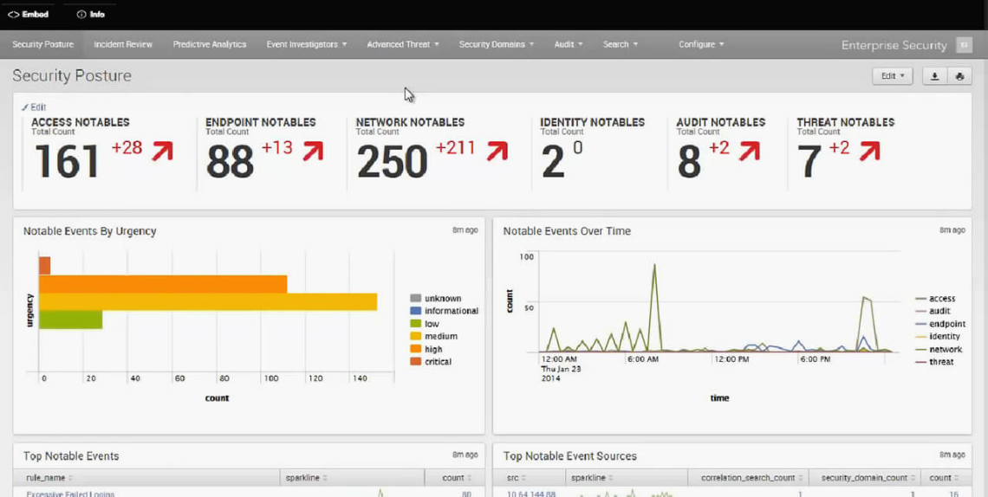
Security Information and Event Management (SIEM) with Splunk Enterprise Security (Splunk ES)
Key Solution - CMP
Splunk Enterprise Security (Splunk ES) is a security information and event management (SIEM) solution that enables security teams to quickly detect and respond to internal and external attacks, to simplify threat management while minimizing risk, and safeguard your business. Splunk ES enables your security teams to use all data to gain organization-wide visibility and security intelligence. Regardless of deployment model on-premises, in a public or private cloud, SaaS, or any combination of these Splunk ES can be used for continuous monitoring, incident response, running a security operations center or for providing executives a window into business risk. Splunk ES can be deployed as software together with Splunk Enterprise or as a cloud service together with Splunk Cloud.
KEY FEATURES
Insight from data that is automatically retrieved from network, endpoint, access, malware, UBA anomalies, vulnerability and identity technologies, and shared to correlate using pre-defined rules or via ad hoc searching
Out-of-the-box capabilities to manage alerts and power dynamic discoveries, contextual searches, and the rapid detection and analysis of advanced threats
Flexibility to customize correlation searches, alerts, reports and dashboards
Improve operational efficiency using workflow-based context for automated and human-assisted decisions
Notes:
Collect and Index Any Machine Data. Using no predefined schema, Splunk Enterprise can collect and index any machine data from virtually any source, format or location in real time. Data streaming from packaged and custom applications, app servers, web servers, databases, wire data from networks, virtual machines, mobile devices, telecoms equipment, operating systems, sensors, mainframes and much more. Simply point Splunk Enterprise at your data and intuitive interfaces guide you through previewing, onboarding and preparing your data, making it more useful for further search and analysis. And for real-time DevOps and IoT data collection, it offers a high-capacity developer-standard HTTP/JSON API and SDKs. Finally, Splunk Enterprise can combine your machine data with data in your relational databases, data warehouses, and Hadoop and NoSQL data stores.

Slide 30
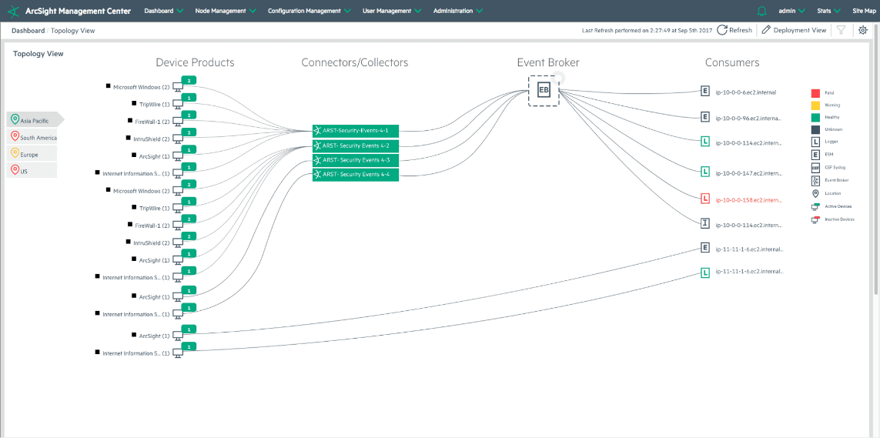
Security Information and Event Management (SIEM) with ArcSight Data Platform by Micro Focus
Key Solution - CMP
Micro Focus® ArcSight Data Platform (ADP) offers a future-ready data solution that enriches data in real time and supports open standards for better threat detection.
Using security data connectors, ADP collects data and enriches it in real-time to give analysts organized information that can be acted upon instantly. With an intelligent Event Broker, built on a foundation of Apache Kafka, ArcSight Data Platform can ingest and broker data from any source, anywhere, seamlessly.
Unleash the Power to Scale through Variety and Velocity With over 400 out-of-box security data connectors and a custom connector creation tool, ADP allows you to collect data from all types of data sources
KEY FEATURES
Event Broker, built with Apache Kafka, ingests data from any source and sends it anywhere
Real-time data enrichment adds security context to raw data, making it instantly usable
400+ out of box connectors collect data from all source types
Centralized management console provides an end to end picture of your security environment
Notes:
Collect and Index Any Machine Data. Using no predefined schema, Splunk Enterprise can collect and index any machine data from virtually any source, format or location in real time. Data streaming from packaged and custom applications, app servers, web servers, databases, wire data from networks, virtual machines, mobile devices, telecoms equipment, operating systems, sensors, mainframes and much more. Simply point Splunk Enterprise at your data and intuitive interfaces guide you through previewing, onboarding and preparing your data, making it more useful for further search and analysis. And for real-time DevOps and IoT data collection, it offers a high-capacity developer-standard HTTP/JSON API and SDKs. Finally, Splunk Enterprise can combine your machine data with data in your relational databases, data warehouses, and Hadoop and NoSQL data stores.

Slide 31
Business intelligence platforms enable enterprises to build BI applications
SOLUTION PORTFOLIO
CURRENT STATE
KEY FEATURES
BUSINESS IMPACT
Build BI applications by providing capabilities in three categories: analysis, such as online analytical processing (OLAP); information delivery, such as reports and dashboards
Real time visibility of All Assets with automatic discovery and monitoring
Holistic view of Service Delivery, infrastructure and Applications across OEM and department silos
Centralized reporting of Assets, OLAs, SLAs and KPIs with drill down capabilities
Reduce costs and secure assets through proactive operations and workﬂows
Increase speed to Identify, diagnose and resolve service outages
Improve customer satisfaction with aligned IT and Business KPIS
Selected OEMs
Source: Team Analysis

Slide 32
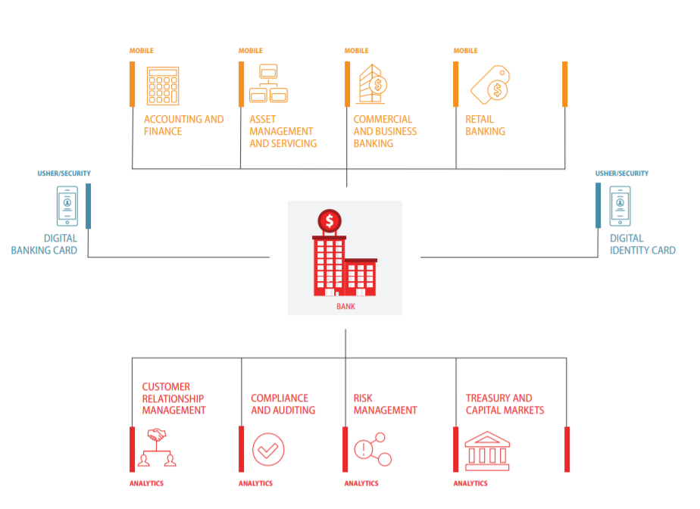
MicroStrategy Enterprise Business Intelligence (BI) and mobility applications
Key Solution – Micro Strategy
The MicroStrategy platform provides all the capabilities organizations need to build and deploy analytics and mobility applications that transform and accelerate business. By putting answers in everyone’s hands, regardless of role, function, or skill level, MicroStrategy’s suite of products helps your organization become an Intelligent Enterprise.
MicroStrategy is an integrated platform upon which
institutions can deploy customized, data driven applications that meet their complex and varied needs. These powerful, secure solutions provide businesses with insight and agility to help them get a competitive edge in today’s saturated market. Leading organizations across the globe rely on MicroStrategy’s analytics and mobility solutions to help reduce costs, drive revenue, enrich the customer experience, and manage risk and regulatory requirements.
KEY FEATURES
Deploy digital credentials to manage, protect, and optimize enterprise assets, resources, and devices.
Empower individuals across the enterprise, by leveraging a centralized platform architecture with governed analytics
Extend existing applications to mobile devices and empower employees wherever they are
Notes:
The challenge
Banking institutions often struggle to maintain various line-of-business reporting tools and are in need of a financial reporting analytics tool that is secure, consistent, and can handle large, complex data sets. Executives require constant up-to-date financial information to run their businesses.
Financial analysis and accounting is imperative to every bank. MicroStrategy financial analysis solutions help ensure that users from executives to accounting analysts are empowered with the insights they need to efciently manage their daily business, make better strategic decisions, and effectively collaborate with their colleagues.
MicroStrategy Mobile apps arm branch managers and employees with real-time insight to help them analyze their business units, customer base, and cross-sell oferings. App users can quickly access branch, product, and channel performance reporting and analysis. They can view KPIs related to deposits, assets, liabilities, staf, and market penetration. Branch managers can quickly access sales activity information for cross-selling and marketing campaigns as well as compare their branch’s performance against others in the region.

Slide 33
Enterprise Service Bus – seamless integration of enterprise applications and services for complex architectures
SOLUTION PORTFOLIO
CURRENT STATE
IT BENEFITS
BUSINESS BENEFITS
Usage of different Standards interpretations between systems
Delay in change propagation to Integrated Systems
Difficulty in managing Asynchronous communication
Cloud Integration
.
Improves business agility
Streamlines business execution
Expands business intelligence
Decreases costs
Greater flexibility
Lowered total cost of ownership (TCO)
Strengthened operational reliability
Decreased risks
Selected OEMs
Notes:
ESB helps organizations streamline and simplify their infrastructure and support Service
Oriented Architecture (SOA) initiatives.

Slide 34
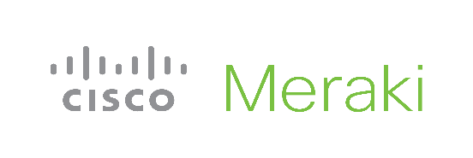
AI enabled Surveillance analyze the audio and images from video surveillance cameras in order to recognize humans, vehicles, objects and events
SOLUTION PORTFOLIO
CURRENT STATE
KEY FEATURES
BUSINESS IMPACT
Near absence of video/surveillance system analytics or systems with low analytic IQ
Failure to cater for the complexities of obscuration and ambiguities in crowded scenes
Failure to cater for complex behaviours and scene semantics
AI Powered Video Analytics with automated response systems
Behavior Analytics in a Crowd (including the detection of abandoned objects, theft, graﬃti, vandalism and car accidents despite obscuration) Ability to detect for asset destruction/ manipulation, Surveillance system health check to prevent camera tampering and sabotage
A.I analytics with smart alerts helps to detect and prevent risk
Automated Queue Management and Crowd control improves operational eﬃciency
Automated Face Recognition improves Service delivery and Quality of Service
Selected OEMs
Source: Gartner, HPE, NetApp, Vmware

Slide 35
Advanced Proactive Monitoring for Interactive voice response (IVR) & customer experience testing suite
SOLUTION PORTFOLIO
CURRENT STATE
KEY FEATURES
BUSINESS IMPACT
Business need to be agile in the way in which they service their customer base
Contact center monitoring is critical for organizations seeking to improve the performance of agents, avoid disruptions and outages and improve the overall customer experience.
Performance Monitoring -Enables managers to track system performance and interactions
Automatically generate an up-to-date and accurate overview of your IVR configurations and fully benchmark existing systems.
ETS Discovery automatically creates fully editable tests scripts to ensure that every element of the customer journey, from connecting via the carrier to speaking with an agent is fully tested and analyzed.
Leverage the power of Artificial Intelligence to gain new insights into your environment.
Optimize the performance of the Contact Center by reducing the impact of outages with system monitoring; resolving issues quickly through automated monitoring.
Selected OEM

Slide 36
Infrastructure Support services reduces Maintenance OPEX by 20% and frees resources for business projects
SOLUTION PORTFOLIO
CURRENT STATE
KEY FEATURES
BUSINESS IMPACT
IT team has limited resources and budget to deploy new projects
High percentage of IT time spent ﬁxing low priority issues
Overstreched IT resources lead to preventables services outages
Trained and Certified technicians to provide operations support
Online, Phone and Onsite IT help desk for swift resolution of tickets
Integrated and Automated ITSM workﬂows for proactive issue remediation
Control IT Opex with ﬁxed cost support contracts and enforceable SLAs
Execute high priority business projects with internal IT team
Reduce non-productive time with proactive maintenance and support
Selected OEMs
Source: Team Analysis

Slide 37
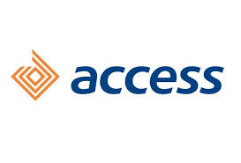
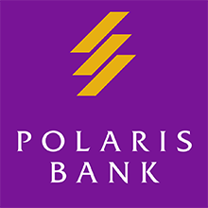
Selected Client List
SELECTED CLIENT LIST
Manifold is a trusted technology partner of Blue Chip International and domestic companies

Slide 38
current and future
CONTACT US
Manifold is ready to meet your
+
business needs
Contact Details
Head Office
22 Awoyemi Close,
Oﬀ Ogunlana Drive Surulere, Lagos State
GENERAL INQUIRIES
contact@manifoldcomputers.com
M (234) 901 628 2357
SALES INQUIRIES
sales@manifoldcomputers.com
M (234) 813 299 2488
SUPPORT INQUIRIES
support@manifoldcomputers.com
M (234) 901 971 9905
Abuja Branch
WAEC House
10 Zambezi CrescentMaitama, Abuja FCT
Port Harcourt Branch
35, Trans-Amadi Road,Rumuobioakani, Port-Harcourt, Rivers State

Slide 39
Thank You!
W W W . M A N I F O L D C O M P U T E R S . C O M

